Slide 1
EXAMPLE Critical Design Review (CDR)
Prof. Daniel Loveless
4/22/2025

Slide 2
Executive Summary
Problem: Random-telegraph-signal (RTS) noise is a known detractor for Focal Plane Array / Read-Out IC (ROIC) designs
Solution: Minimize RTS noise contributors in a commercial 90 nm bulk CMOS technology (C90)
Objective / Goal: Identify root cause(s) / contributors of RTS noise (through 3 process revisions, DOE-1/2/3) and develop appropriate responses to minimize or eliminate the adverse effects of these contributors in C90
This critical design review (CDR) for DOE-3 documents the proposed changes to existing test structures to fix known issues with DOE-1 and DOE-2 and for improvement of measurement capabilities.
UNCLASSIFIED//FOUO

Slide 3
DOE-3 Objectives
DOE-1 Objectives:
Framework for large-scale RTS characterization of active C90 devices
Eight primary transistor types implemented with various aspect ratios
DOE-2 Objectives:
Improvement/upgrade of RTS measurement approach; RTS benchmarking
Demonstration of RTS in ROIC sub-circuits
Characterize baseline sensitivity of C90 process to ionizing radiation
DOE-3 Objectives:
Fix the known issue with DOE-1 pMOS array
Fix known issue with DOE-2 DICE shift register
Include annular gate transistor arrays for RTS and radiation effects evaluation
UNCLASSIFIED//FOUO

Slide 4
Anticipated Timeline
CDR (date)
GDS Submission (date)
Tapeout (date)
SEE Rad testing of DOE-2 (date)
DOE-3 Packaging (date)
RTS and Radiation testing of DOE-3 begins (date)
UNCLASSIFIED//FOUO

Slide 5
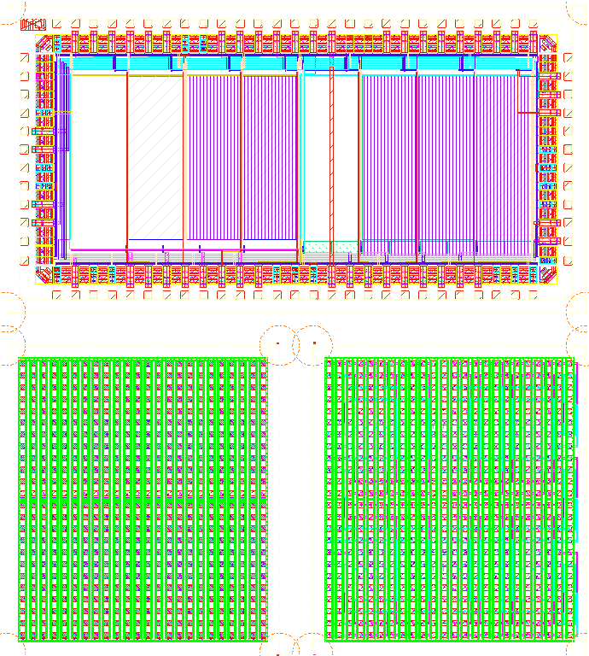
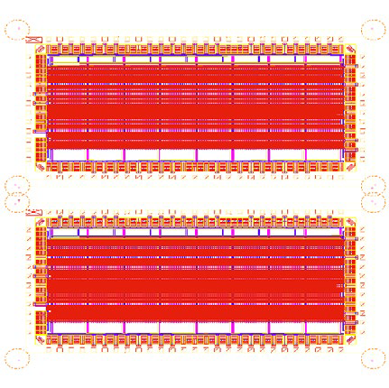
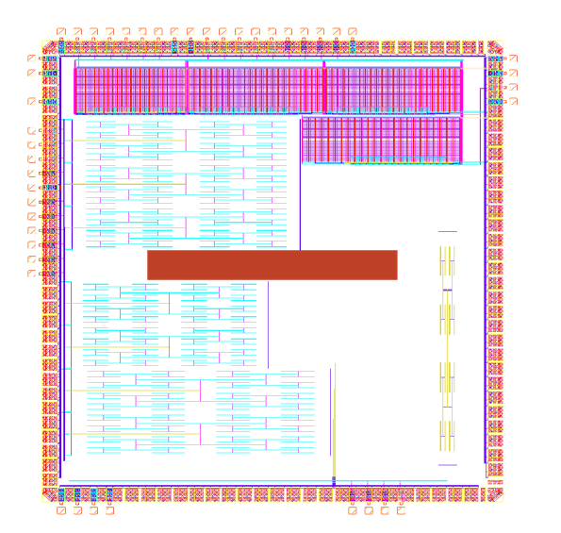
DOE-1, DOE-2, DOE-3 Designs
DOE-1
DOE-2
DOE-3
CTIA
RadFX
DOE-1-v3
Fixed issue with pMOS source follower array
Added high-voltage annular structures to Probe Array (Chiplet 2)
DOE-2-CTIA-v3
No changes
DOE-2-RADFX-v3
Repaired issue with DICE
Built-in-self-test for:
RTS capture
Source followers
Issue with pMOS array in Chiplet 1
Built-in-self-test for:
RTS capture
CTIA
No known issues
Built-in-self-test for:
Radiation Characterization
Known issue with DICE shift reg.
UNCLASSIFIED//FOUO

Slide 6
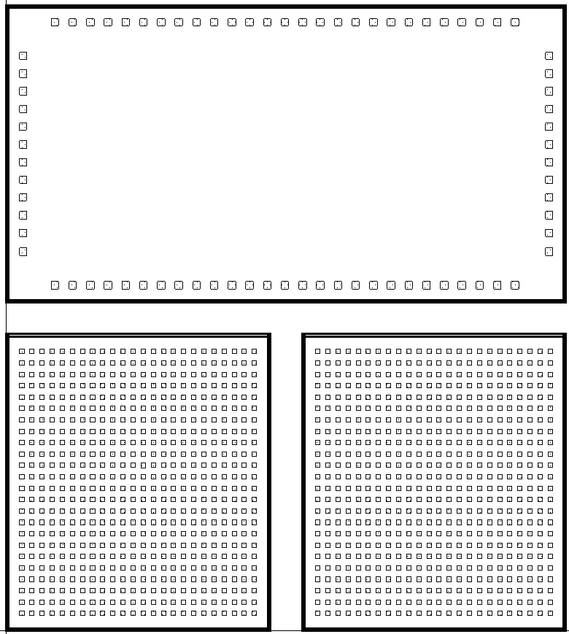
DOE-3 (DOE-1-v3)
4.430 mm x 4.945 mm
Divided into 3 chiplets
Chiplet 3
Two 2.3 mm x 2.1 mm
One 4.6 mm x 2.1 mm
Chiplet 1 (24 x 24 probe pads)
Transistor array to include:
SC and BC devices
W/L variants
Thick and thin oxide variants
Bulk (p-substrate) and deep n-well
Chiplet 1
Chiplet 1A
Chiplet 1A (24 x 24 probe pads)
Transistor arrays to include HV annular devices
Chiplet 3 (78 bond pads)
On-chip RTS transistor array with repaired pMOS
UNCLASSIFIED//FOUO

Slide 7
DOE-3 Chiplet 1 RTS Source Follower Array
UNCLASSIFIED//FOUO

Slide 8
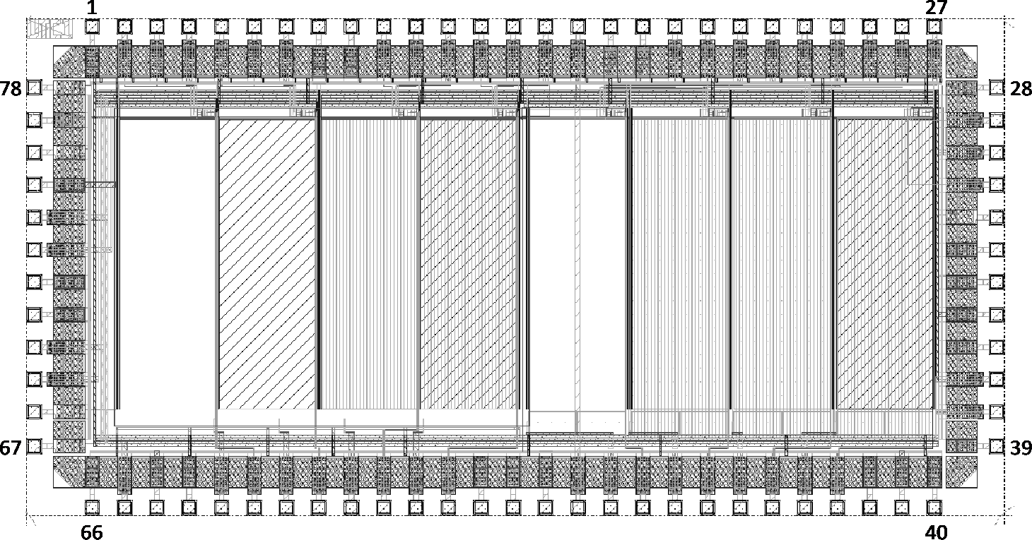
DOE-1-v3 On-Chip RTS Structures
On-chip RTS measurement uses a built-in-self-test (BIST) architecture for testing of a large transistor array (~2x104 transistors – 256x96)
Transistors configured as source- follower amplifiers with on-chip current source bias
Analog array with 8 channels
Packaged in a 100-pin LCC
Bond pad pitch is 140 𝝁m (70 𝝁m x 70 𝝁m pad size)
I/O cells with electro-static discharge (ESD) protection
UNCLASSIFIED//FOUO

Slide 9
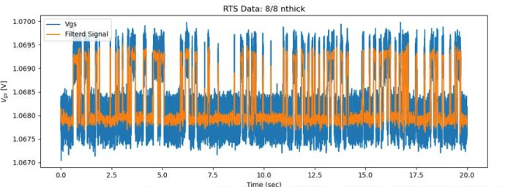
DOE-1-v3 On-Chip RTS Structures
CS(i)
V_{N}
V_{P} BH
The device under test (DUT) within each Unit Cell will be biased as a source follower using an on-chip current source (I_{DS}) and an externally applied gate bias (V_{G})
ΔV_{S} is measured via an on-chip amplifier, thus allowing for extraction of ΔV_{GS}
Unit Cell
V_{G}
^{V}OUT
ΔV_{S}
RS(j)
RTS manifests as discrete shifts in V
Capture (𝞃_{C}) and emission (𝞃_{E}) time constants will be measured
^{I}REF
I
^{V}gs ^{= V}G^{-V}OUT
GS
DS
A typical measurement:
~60 sec (2KHz bandwidth)
Bias setup: 20 sec
DC measurement: 2 ~ 5 sec
RTS Sampling: 20 sec
UNCLASSIFIED//FOUO

Slide 10
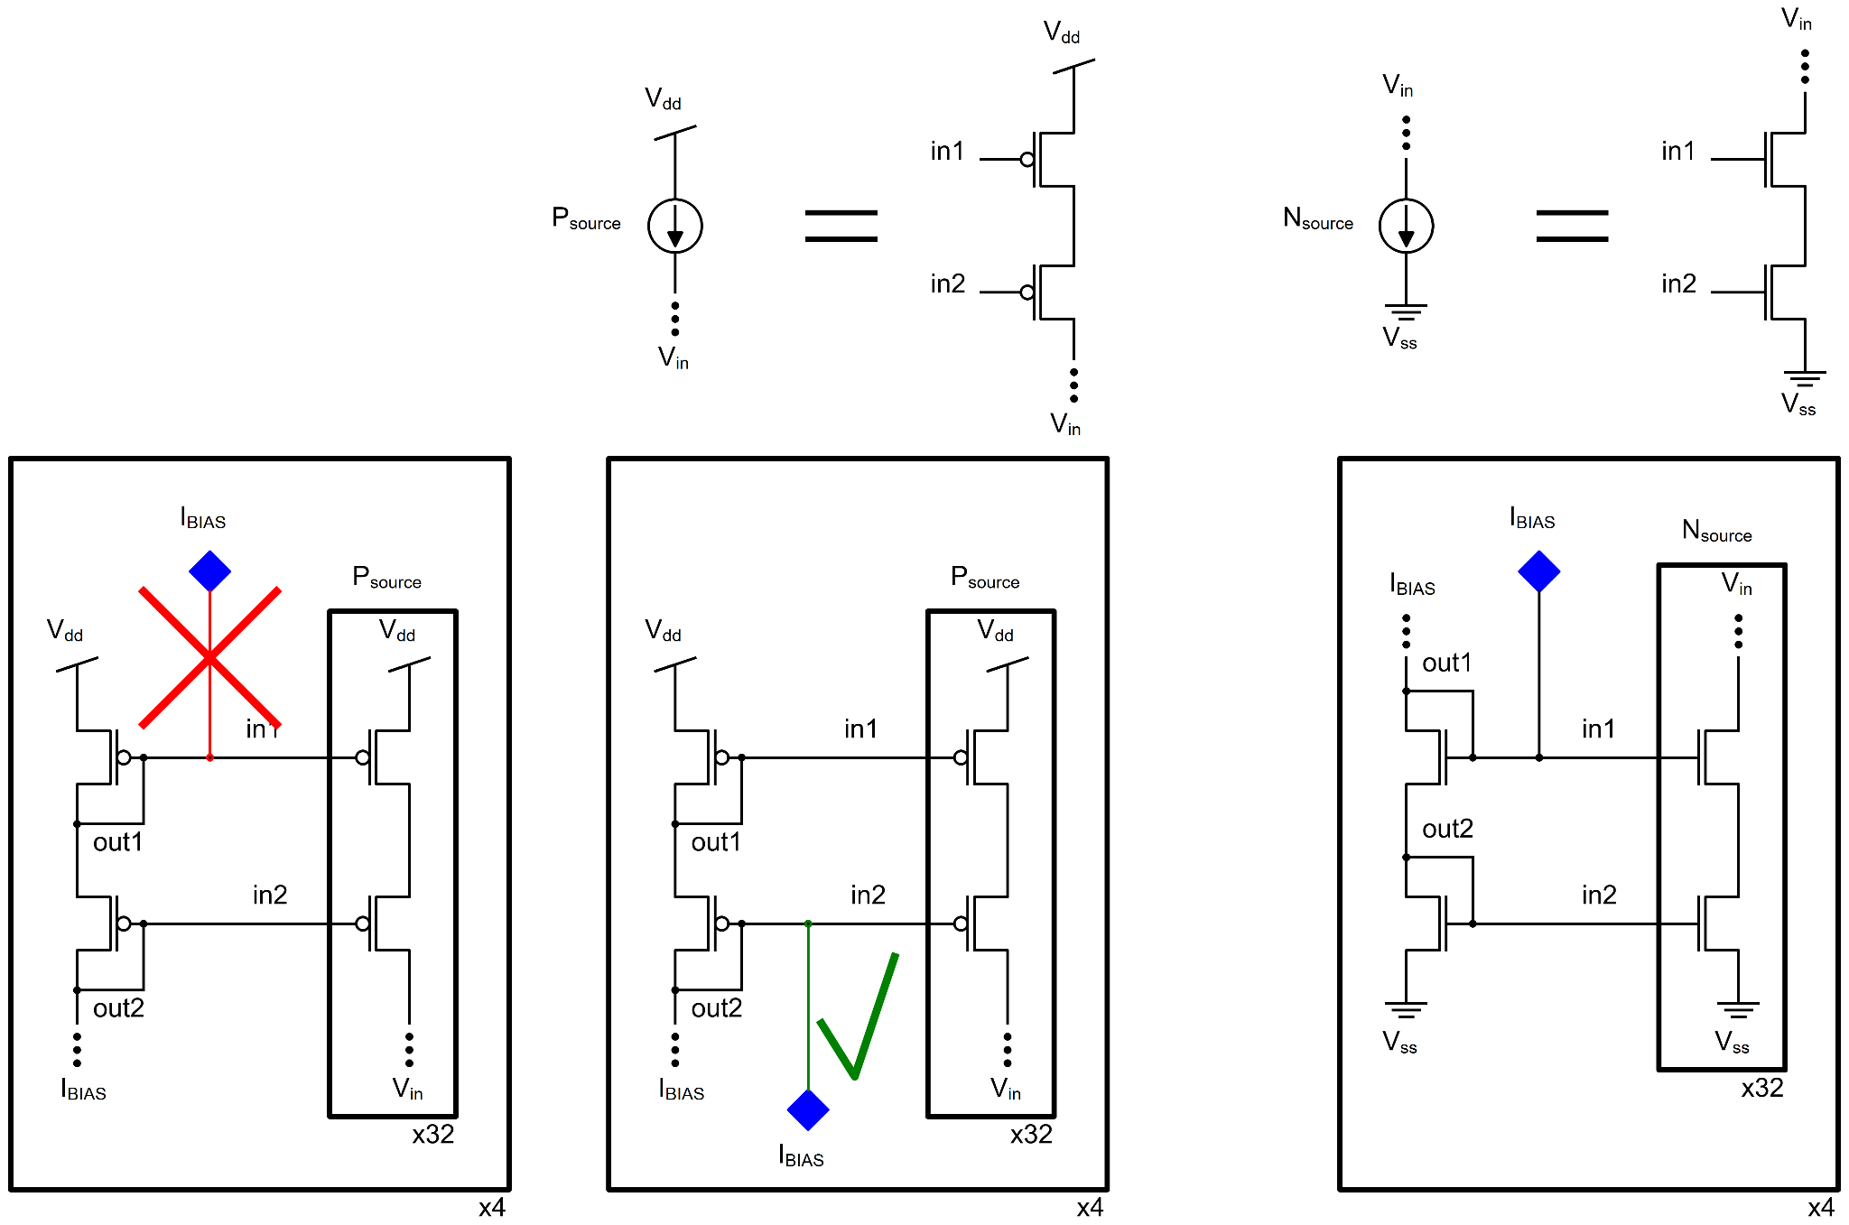
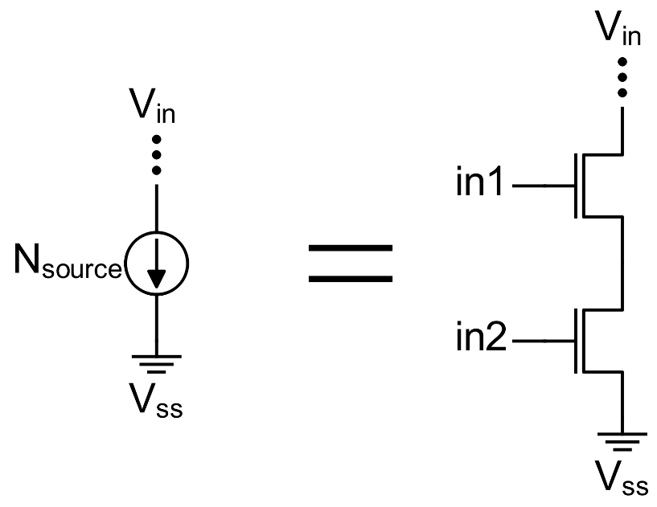
DOE1 NMOS Current Source
NMOS is correct
IBIAS is connected to the first cascaded MOS
UNCLASSIFIED//FOUO

Slide 11
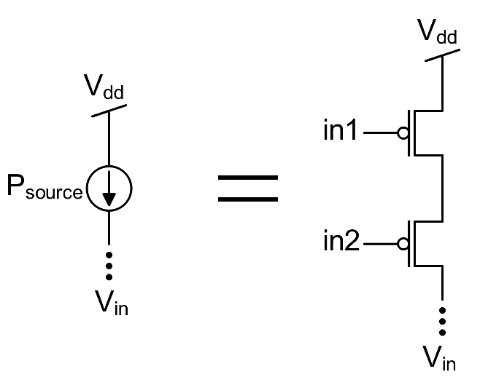
DOE1_v3 PMOS Array Fix
PMOS cell correct, however, the external reference pin was connected to the wrong node
IBIAS was connected to the second cascaded MOS
UNCLASSIFIED//FOUO

Slide 12
DOE1_v3 PMOS Array Fix
PMOS is correct
IBIAS is connected to the first cascaded MOS
UNCLASSIFIED//FOUO

Slide 13
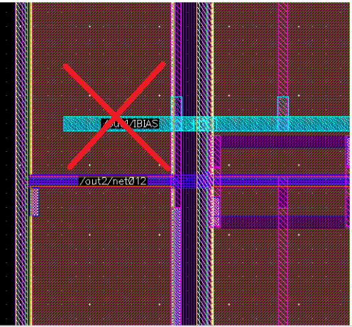
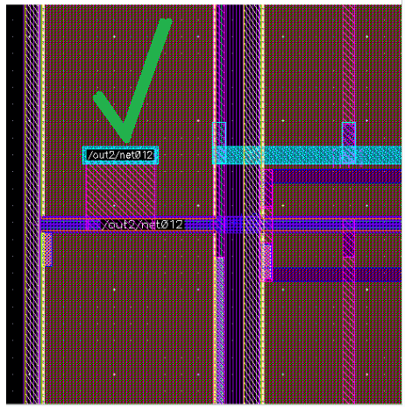
DOE1_v3 PMOS Array Fix - Layout
UNCLASSIFIED//FOUO

Slide 14
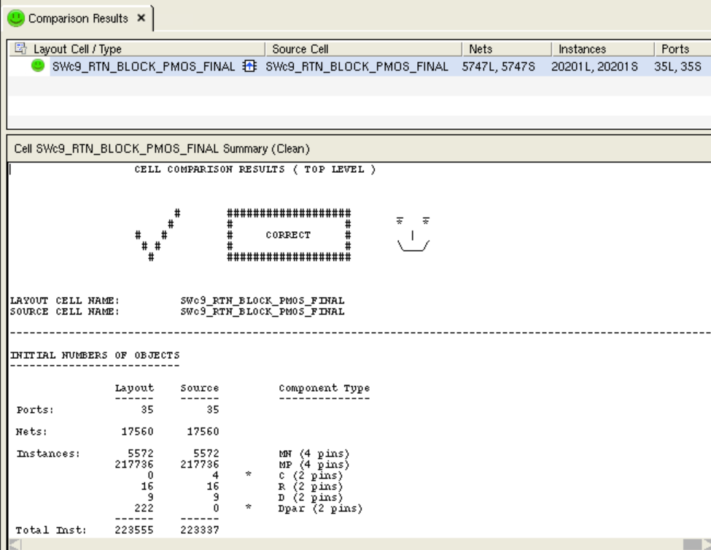
DOE1_v3 PMOS Array Fix - LVS
UNCLASSIFIED//FOUO

Slide 15
DOE-3 RADFX
UNCLASSIFIED//FOUO

Slide 16
DOE-2/3 Radiation Effects Test Coupon (RADFX)
Single-event transients (SET)
SETs are a fundamental circuit-level response critical for model calibration
Large targets of combinational logic (INV, NAND, OR) will be used to generate SETs (with expected pulse widths between 50 ps and 1 ns) captured by an on-chip time-to-digital converter (TDC)
Single-event upsets (SEU)
Single-event effects that result in a change in the state of memory
Shift registers designed from Skywater standard cell flip-flops and a radiation-hardened cell will be used to determine the critical charge to upset
Shift registers will be laid out with varying well/substrate contact densities to characterize critical charge versus tap spacing
Single-event latchup (SEL)
Potentially destructive response to single-event effects due to coupled parasitic bipolar devices
The entire test article will be used to screen the process and the shift registers (with varying contact densities) used to characterize if necessary
Total-Ionizing Dose (TID)
Transistor test arrays (bonded or probed) used to characterize shifts in threshold voltage and leakage current
On-chip ring-oscillators used to measure shifts in drive current
UNCLASSIFIED//FOUO

Slide 17
DOE-2/3 Radiation Effects Test Coupon (RADFX)
Single-event transients (SET)
SETs are a fundamental circuit-level response critical for model calibration
Large targets of combinational logic (INV, NAND, OR) will be used to generate SETs (with expected pulse widths between 50 ps and 1 ns) captured by an on-chip time-to-digital converter (TDC)
Single-event upsets (SEU)
Single-event effects that result in a change in the state of memory
Shift registers designed from Skywater standard cell flip-flops and a radiation-hardened cell will be used to determine the critical charge to upset
Shift registers will be laid out with varying well/substrate contact densities to characterize critical charge versus tap spacing
Single-event latchup (SEL)
Potentially destructive response to single-event effects due to coupled parasitic bipolar devices
The entire test article will be used to screen the process and the shift registers (with varying contact densities) used to characterize if necessary
Total-Ionizing Dose (TID)
Transistor test arrays (bonded or probed) used to characterize shifts in threshold voltage and leakage current
On-chip ring-oscillators used to measure shifts in drive current
The dual-interlocked cell (DICE) on DOE-2-RADFX has some timing issues – this will be corrected in DOE-3
UNCLASSIFIED//FOUO

Slide 18
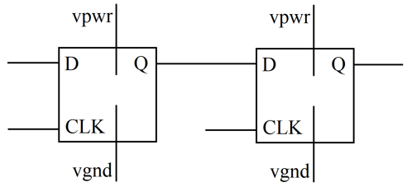
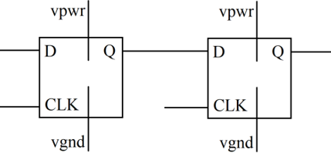
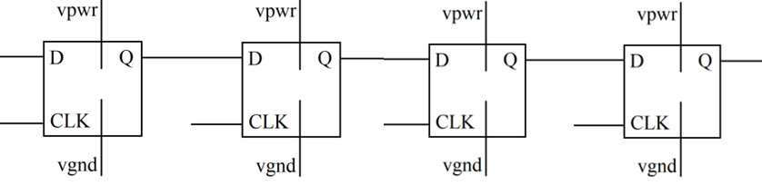
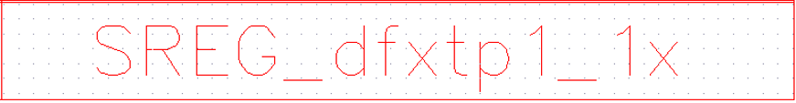
Shift Registers (SREG) – H Clocking Method
UNCLASSIFIED//FOUO

Slide 19
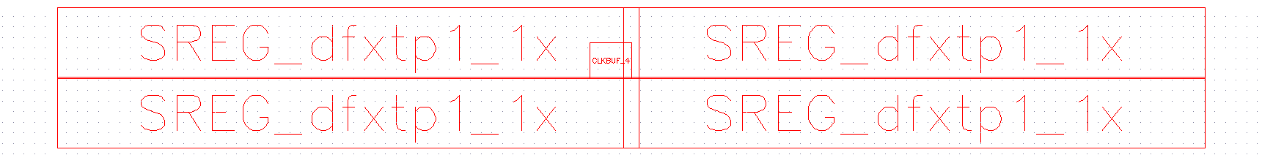
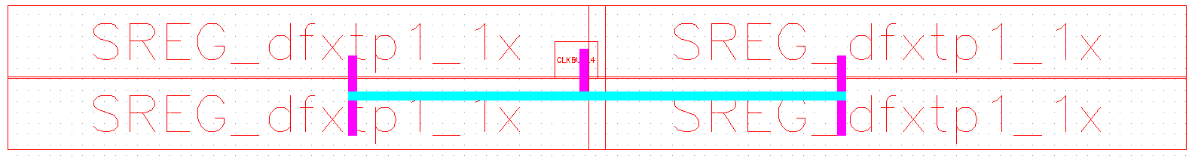
Shift Registers (SREG) – H Clocking Method
UNCLASSIFIED//FOUO

Slide 20
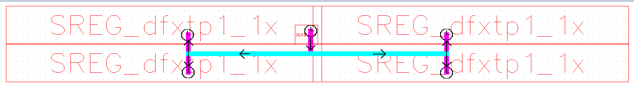
Shift Registers (SREG) – H Clocking Method
UNCLASSIFIED//FOUO

Slide 21
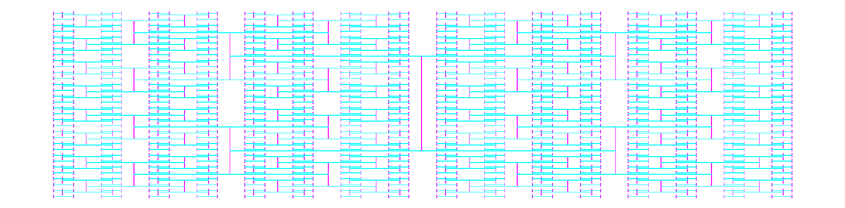
Shift Registers (SREG) – H Clocking Method
UNCLASSIFIED//FOUO

Slide 22
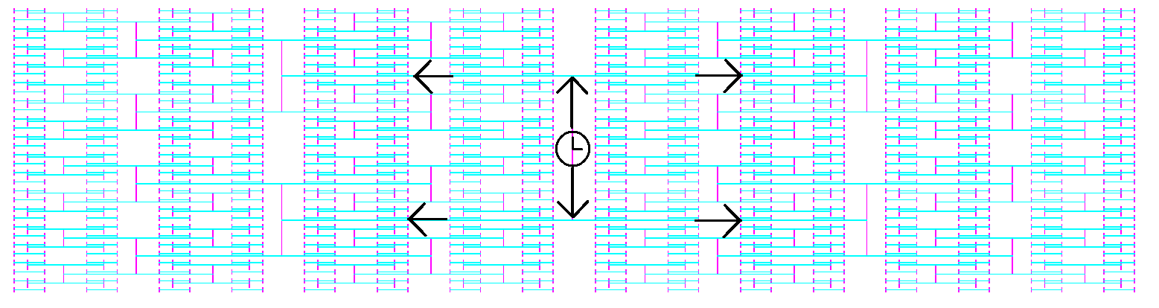
Shift Registers (SREG) – H Clocking Method
UNCLASSIFIED//FOUO

Slide 23
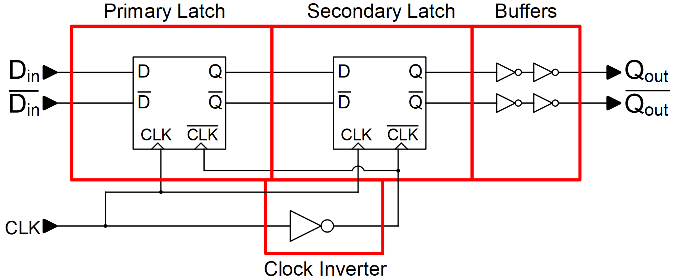
DICE Schematic
UNCLASSIFIED//FOUO

Slide 24
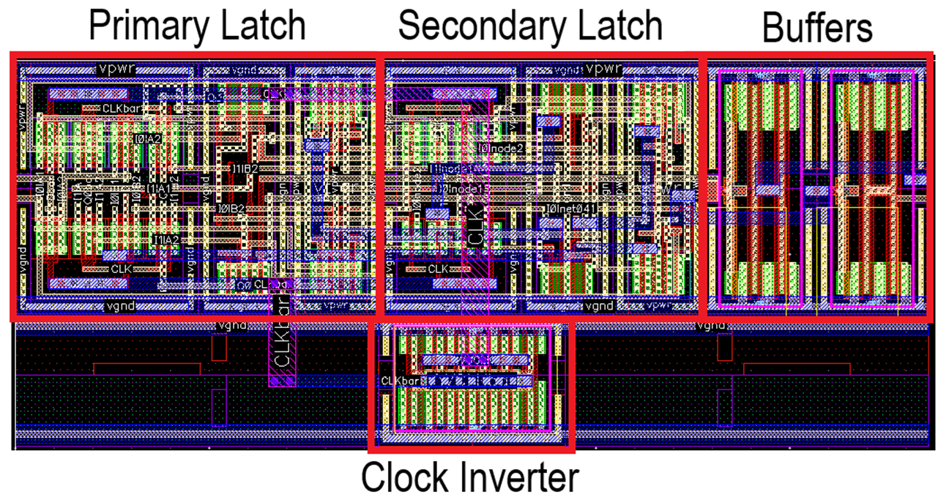
DICE Layout
UNCLASSIFIED//FOUO

Slide 25
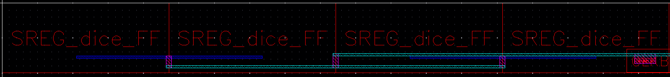
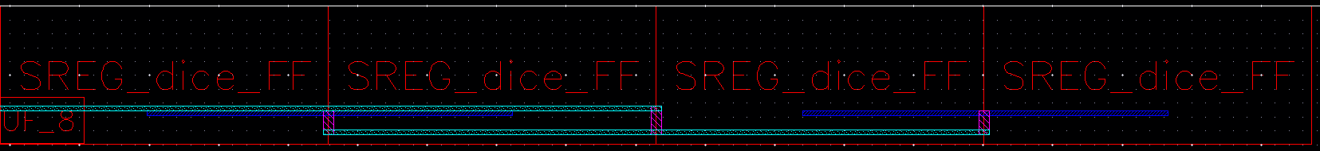
DICE Shift Register Layout
1x 2x 3x 4x
5x 6x 7x 8x
UNCLASSIFIED//FOUO

Slide 26
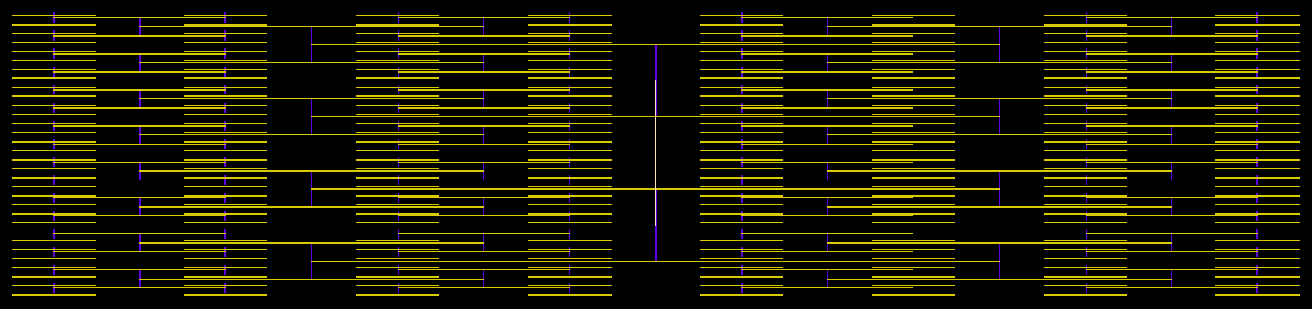
DICE 1024x Shift Register
Design Choice: H-Tree clocking
Why: All flip-flops are clocked simultaneously
UNCLASSIFIED//FOUO

Slide 27
DICE Size Increase → 32.47%
UNCLASSIFIED//FOUO

Slide 28
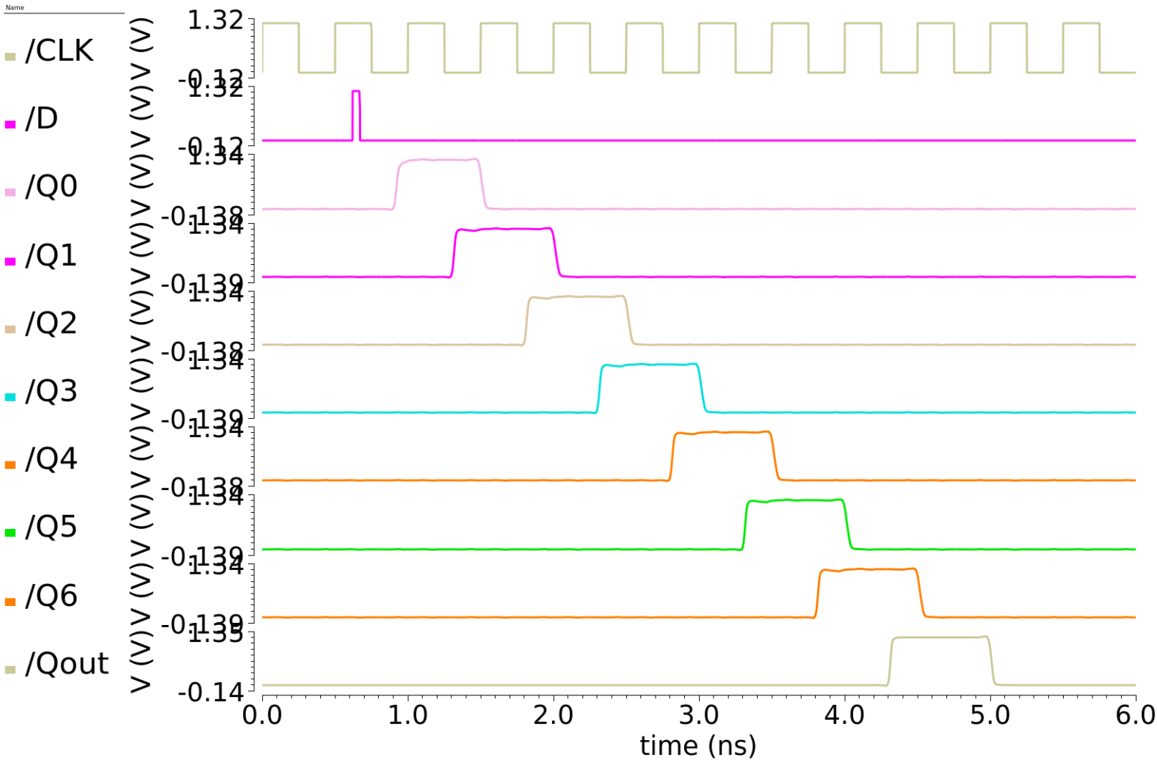
DICE Functionality
Frequency: 2 GHz
Pulse Width: 50 ps
UNCLASSIFIED//FOUO

Slide 29
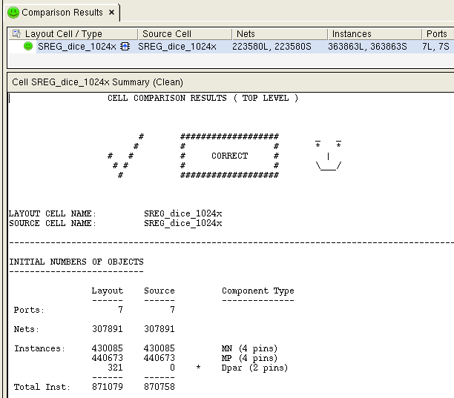
DICE - LVS
UNCLASSIFIED//FOUO

Slide 30
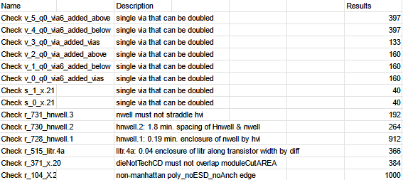
DRC Rule Waivers Needed
UNCLASSIFIED//FOUO

Slide 31
Summary
This critical design review (CDR) for DOE-3 documents the proposed changes to existing test structures to fix known issues with DOE-1 and DOE-2 and for improvement of measurement capabilities.
All designs are 100% complete
The final pattern density fill is currently being synthesized
GDS files will be delivered to manufacturer by <date>
DOE-3
DOE-1-v3
Fixed issue with pMOS source follower array
Added high-voltage annular structures to Probe Array (Chiplet 2)
DOE-2-CTIA-v3
No changes
DOE-2-RADFX-v3
Repaired issue with DICE
UNCLASSIFIED//FOUO

